Slide 1
Structure property relationship
DP
Molecular chemistry; Effect of side groups and polar groups. Also presence of double bonds and aromatic groups in backbone of chain.
Crystallinity
Tacticity
Other factors affecting properties:
Molecular weight
Degree of branching

Slide 2
plastics
Polymers are characterized by low strengths, low melting temperatures, and poor electrical conductivity.
Plastics include largest number of different polymeric materials
Plastics are polymeric materials consisting of other additives that enhance their properties.
They have wide variety of combination of properties because all molecular structures and configurations are possible.
Can be thermoplastics or thermosetting or even elastomers
In order to be considered plastics, linear or branched polymers must be used below T_{g} (if amorphous) and below T_{m} (if semicrystalline) or crosslinked to maintain the shape.
College of Engineering Pune (COEP)
Forerunners in Technical Education

Slide 3
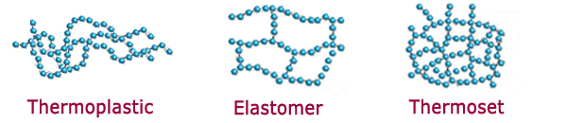

Slide 4
Thermal properties
Melting temperature (T_{m}) – The melting of a polymer crystal corresponds to the transformation of a solid material (having an ordered structure of aligned molecular chains) into a viscous liquid in which the structure is highly random. Melting of polymers takes place over a range of temperatures
Glass transition temperature – The temperature at which the polymer experiences the transition from rubbery into rigid states is termed the glass transition temperature, Tg. Upon cooling, the glass transition corresponds to the gradual transformation from a liquid into a rubbery material and finally into a rigid solid
Heat deflection temperature – It is the temperature at which a given deformation of a beam occurs for a standard load. It is the measure of the stiffness of material as temperature increases.

Slide 5
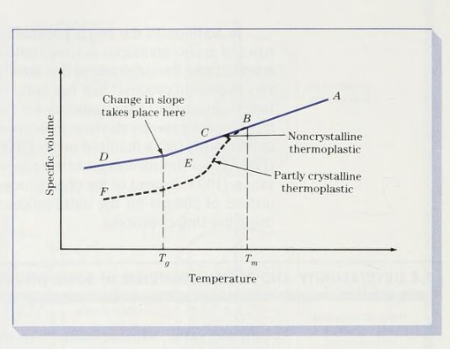
T_{m} and T_{g} also influence the fabrication and processing procedures for polymers and polymer–matrix composites
Normally the value of Tg lies somewhere between 0.5 Tm and 0.8 T_{m} (in Kelvin)

Slide 6
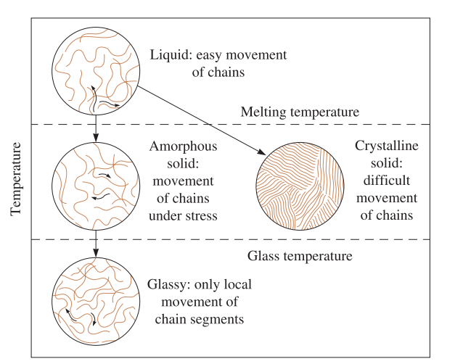
Effect of T on behavior of thermoplastics

Slide 7
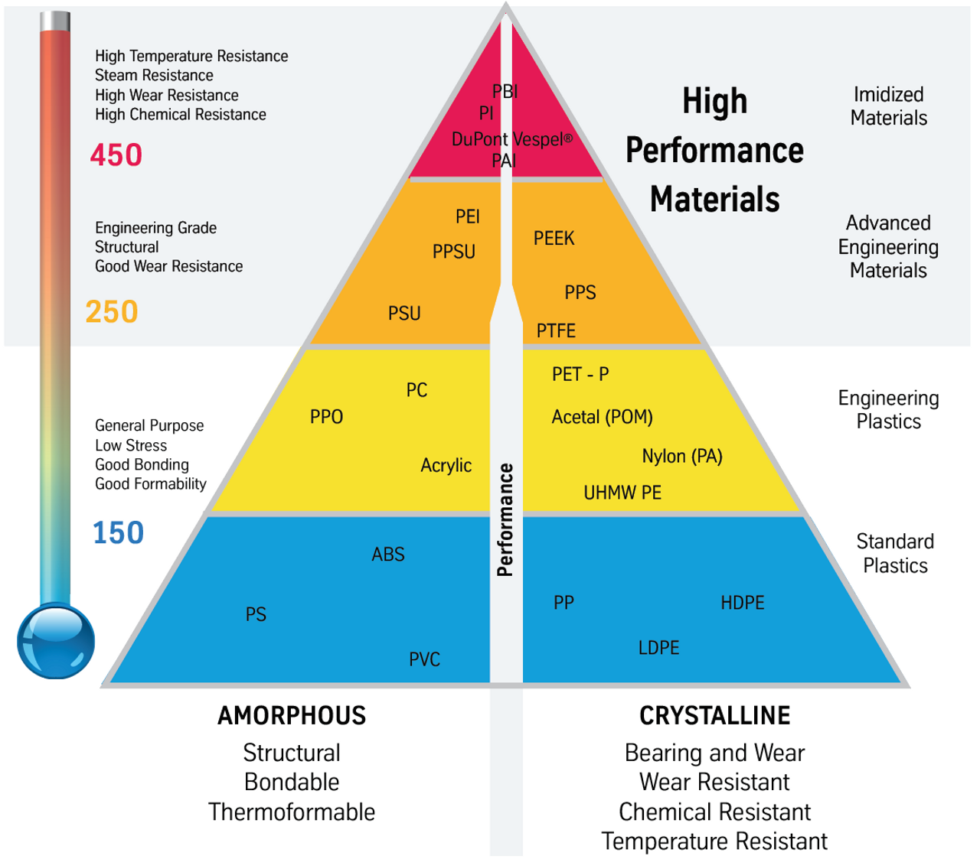

Slide 8
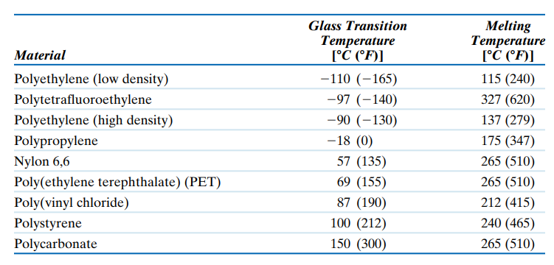

Slide 9
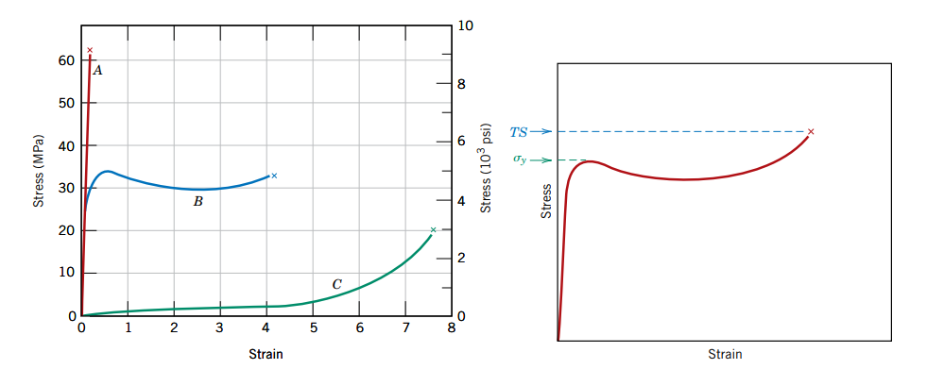
Modulus, Tensile & Yield strength
The stress–strain behavior for brittle (curve A), plastic (curve B), and highly elastic (elastomeric) (curve C) polymers
Schematic stress–strain curve for a plastic polymer showing how yield and tensile strengths are determined

Slide 10
Mechanical properties
Stiffness (or rigidity) - a property of a polymers that is described by Flexural modulus or bending modulus of elasticity. It is therefore one of the most important properties of solid materials. Flexural Modulus denotes the ability of a material to bend.
Hardness - resistance of a material to localized plastic deformation/represents a material’s resistance to scratching, penetration etc. Measuring hardness levels can help predict the ability of the material to recover after being indented through force.
Toughness - the ability of a polymer to exhibit plastic deformation/ability of material to absorb energy during plastic deformation. Area under stress strain curve.
Impact strength – related to overall toughness of material. Impact strength is the measure of the ability of a material to resist cracking, fracturing, or plastic deformation under sudden and intense impact. Energy absorption directly related to brittleness of material. Izod or Charpy tests are ordinarily used to assess impact strength

Slide 11
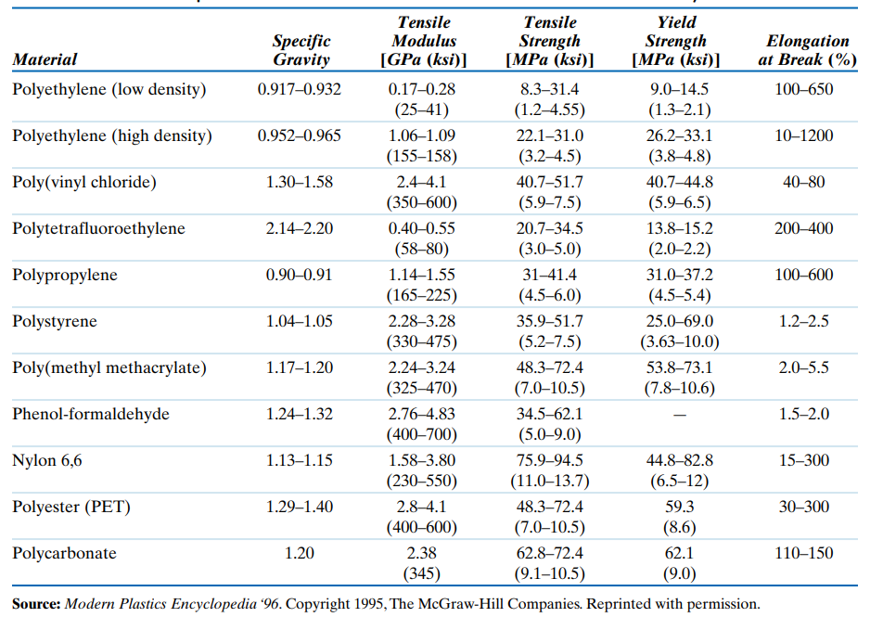
Room temperature mechanical characteristics of common polymers

Slide 12
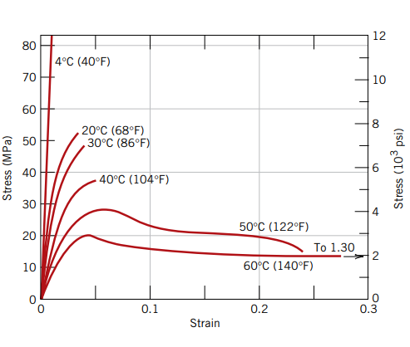
Effect of Temp on stress strain behaviour
PMMA polymer
PMMA polymer
Increasing the temperature produces (1) a decrease in elastic modulus, (2) a reduction in tensile strength, and (3) an enhancement of ductility

Slide 13
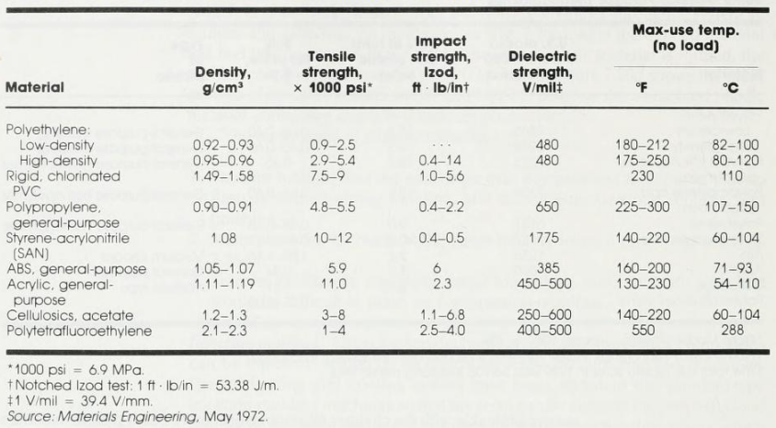
General properties of thermoplastics
College of Engineering Pune (COEP)
Forerunners in Technical Education

Slide 14
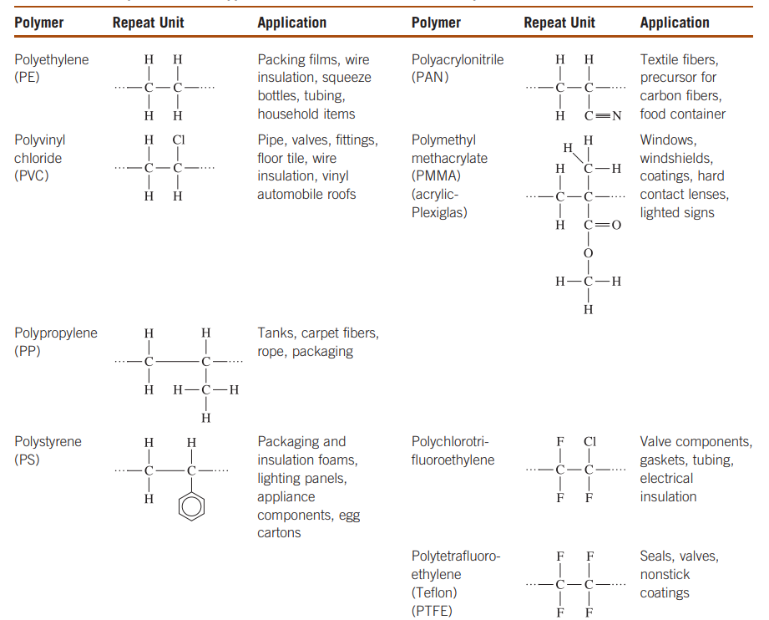
General thermoplastics
College of Engineering Pune (COEP)
Forerunners in Technical Education

Slide 15
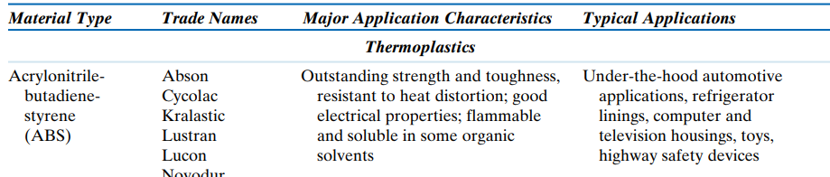
General thermoplastics
College of Engineering Pune (COEP)
Forerunners in Technical Education

Slide 16
Commodity/general-purpose thermoplastics
Commercial—or standard commodity—polymers are lightweight, corrosion-resistant materials with low strength and stiffness, and they are not suitable for use at high temperatures.
Examples of such type of plastics are PE, PP, PVC, PS, HIPS and ABS

Slide 17
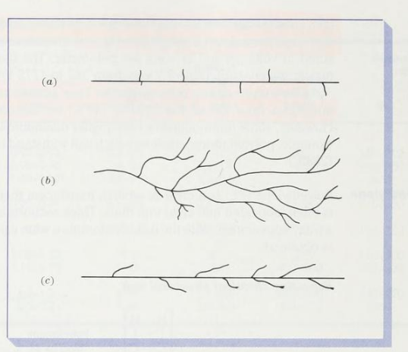
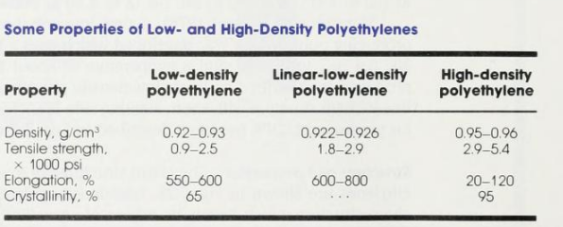
Polyethylene
High density
TYPES OF PE
Low density
Linear low density

Slide 18
Properties of PE
High Density PE Ziegler-Natta polymerization allows controlled growth of long and linear PE
Low Density PE free radical polymerization (no catalyst controls chain growth, side branching possible)
Polymer | Properties
LDPE | Soft, waxy solid
HDPE | Rigid, translucent solid
College of Engineering Pune (COEP)
Forerunners in Technical Education

Slide 19
Properties of PE
Advantages:
Good chemical and moisture resistance
Low cost
Electrical insulator
Disadvantages:
Poor weather resistance (UV)
Poor bonding to other surfaces or solvents
High thermal expansion

Slide 20
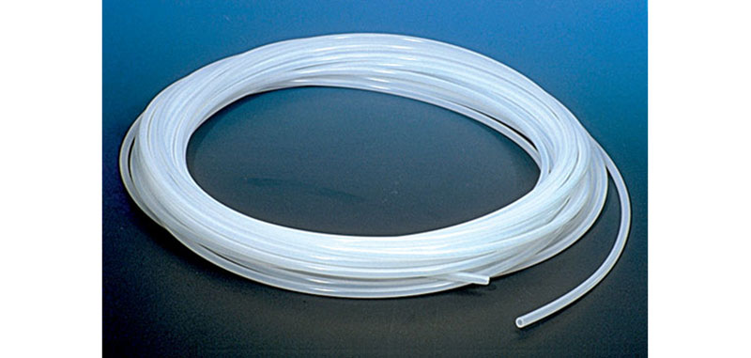
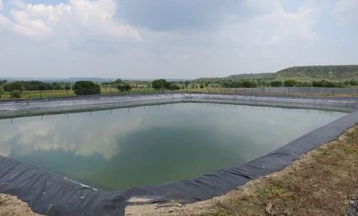
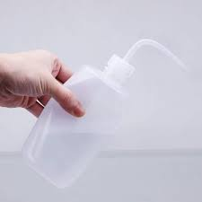
Applications of PE
LDPE – films and tubing
Other low strength applications – squeeze bottle and other household items
HDPE – milk jugs ( stronger than LDPE)
Chemical storage tanks (good chemical and solvent resistance)
Grocery bags (strength)
Pond liners
LLDPE – Stiffer and greater impact strength than LDPE
Food packaging, shrink wrap
LDPE tubing
LDPE squeeze bottle
Pond liner

Slide 21
PVC
Chlorine atom makes it essentially amorphous
Cl also produces steric hindrance -→ reduces flexibility
Immobility makes processing difficult, hence compounded with additives to produce compounds with different physical and chemical properties.
Properties – wide range of flexibility by adding plasticizers
Van der Waals forces provide an extra binding force between the chains of these polymers. (shown on next slide). This makes PVC relatively more brittle; materials known as plasticizers are added to enhance PVC ductility
Relatively high strength and brittleness
Good electrical properties
High flame and chemical resistance ( due to high Cl content)
Medium heat deflection temperature
Good UV resistance
Applications: pipe, electric cables, window frames, floor mats, garden hoses

Slide 22
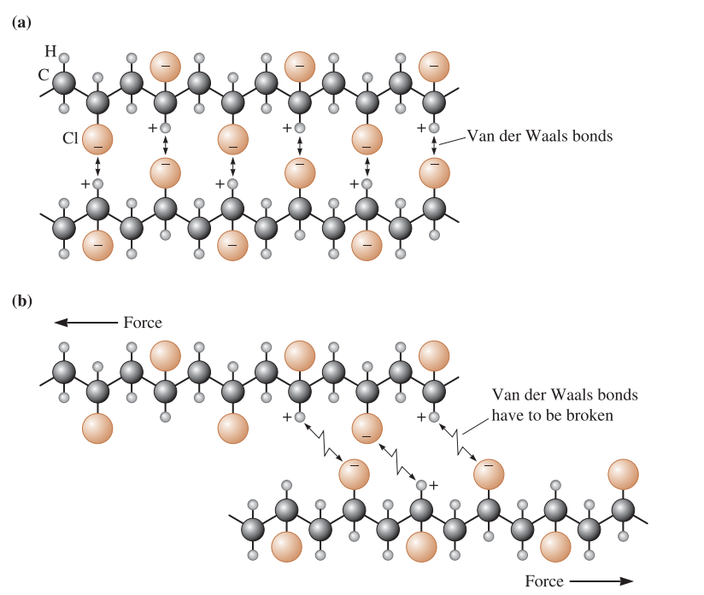

Slide 23
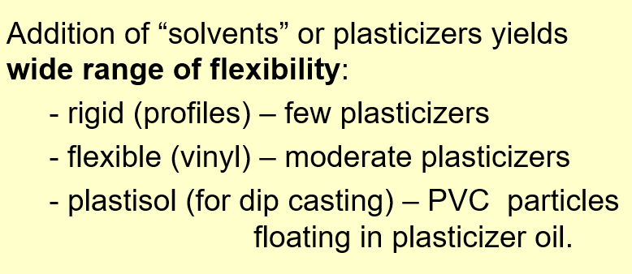
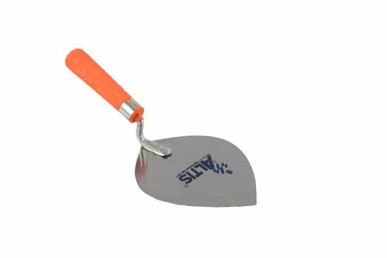
Plasticizers: high MW compounds miscible with polymer. Phthalate esters for PVC Other additives : heat stabilizers, lubricants, fillers (to lower cost), pigments. Rigid – pipe, gutters, windows Flexible – medical blood bags Plastisol – gloves, tool handle covers Disadvantages of PVC: thermally unstable and attacked by acetone and methylene chloride
Tool handle

Slide 24
PP
PE + pendant methyl group (restricts rotation of chain)
One of the lowest in cost as it can be synthesized from low-cost petrochemical raw materials.
Semicrystalline
Isotactic PP : highly crystalline made by Zieglar Natta polymerization
Atactic PP : ‘sticky glue’
PP vs. PE:
Stronger and stiffer
Higher melting, service and heat deflection temperature

Slide 25
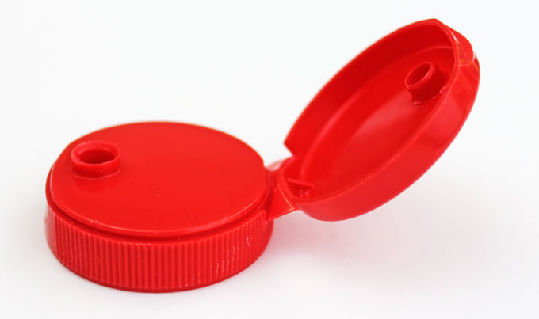
PP
Good chemical, moisture and heat resistance
High service temperatures – around 120⁰C
Good surface hardness
Outstanding flex life as a ‘hinge’
Applications:
Heater duct
Sterilizable medical devices (Disposable syringes, surgical trays)
Dishwasher and microwave safe food containers
Carpet fibers, ropes
Disadvantages:
poor UV resistance

Slide 26
PS
Addition polymer
Benzene interferes with crystalline formation – making it amorphous
Brittleness due to benzene – molecules cannot slide past each other
Inflexible at room temperature
Clear and rigid polymer
Low mold shrinkage
Easily bonded with solvents so can be chemically attacked by solvents and oils.
Used to produce important copolymers

Slide 27
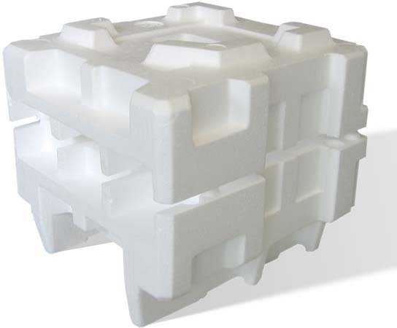
Applications of PS
Disposable eating ware: cups, forks, plates
Thermocol (Expanded polystyrene) : packaging, insulation

Slide 28
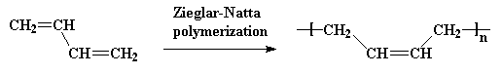
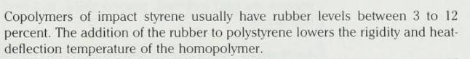
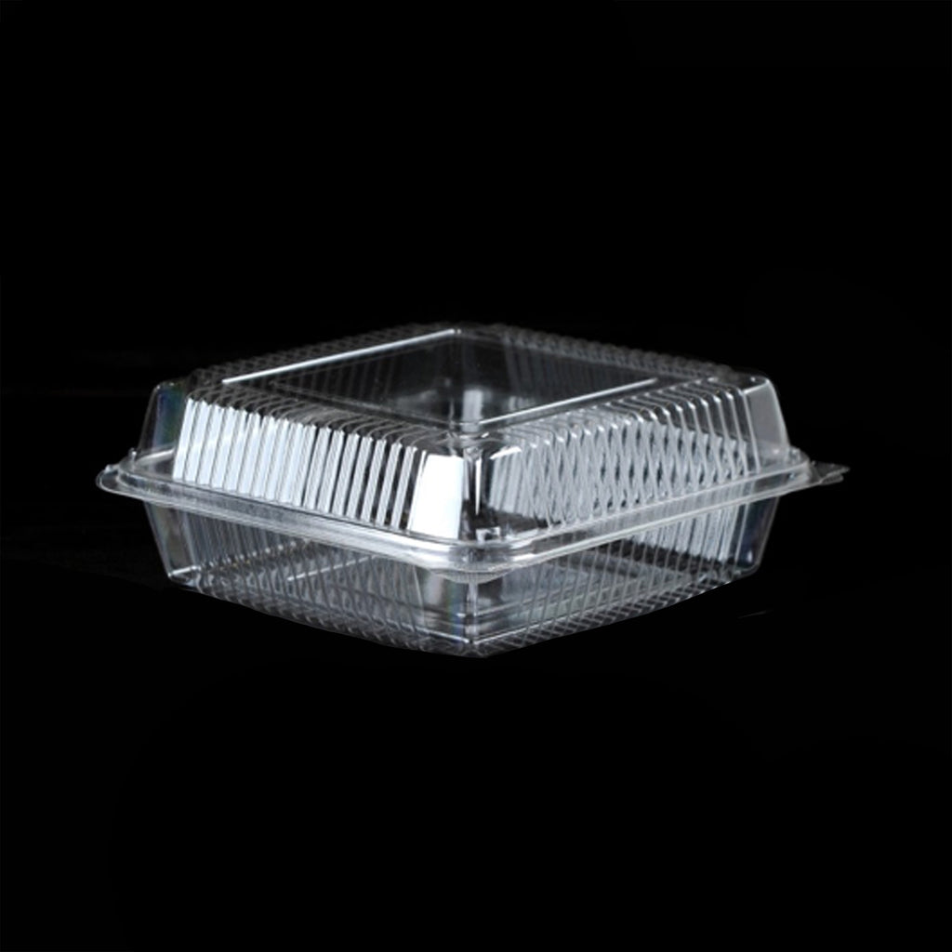
HIPS
High Impact Polystyrene
Used in packaging : clam shells, cups and lids
Copolymerization of styrene with polybutadiene improves impact toughness.
Polybutadiene

Slide 29
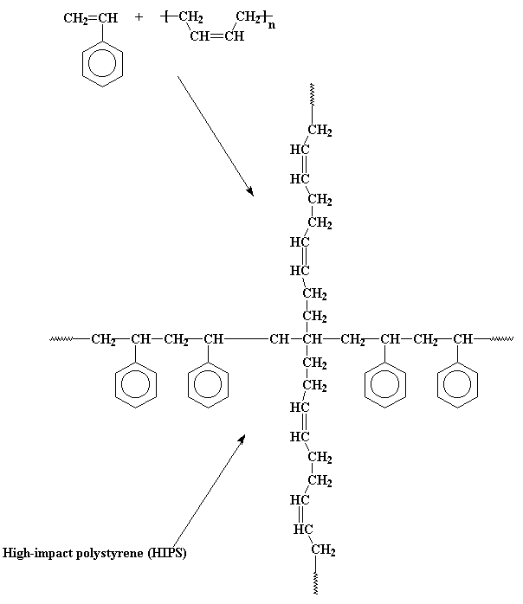

Slide 30
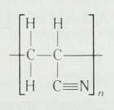
Polyacrylonitrile (PAN)
Acrylic type material
Molecular chains are forced into stiff, rodlike structures due to highly electronegative nitrile group on every other C atom which exerts mutual electrical repulsion.
Regularity of rodlike structures allows them to orient themselves to produce strong fibers by H-bonding between polymer chains. As a result, acrylonitrile is used in the form of fibers because of properties like high Strength and good resistance to moisture and solvents (chemical stability).
Applications: Used in fiber form for applications such as blankets and sweaters. Also, used as a comonomer in SAN (Styrene-Acrylonitrile) and ABS copolymers.

Slide 31
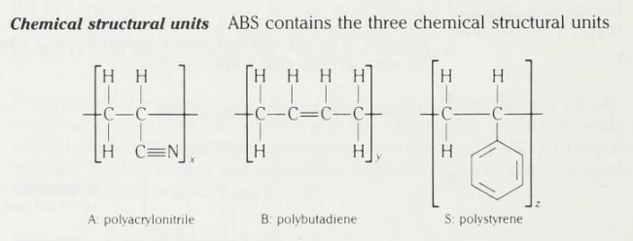
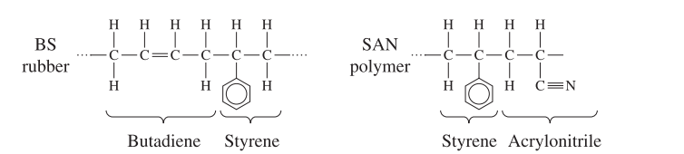
ABS
Copolymerization produces the polymer ABS, which is really made up of two copolymers, SAN and BS, grafted together.

Slide 32
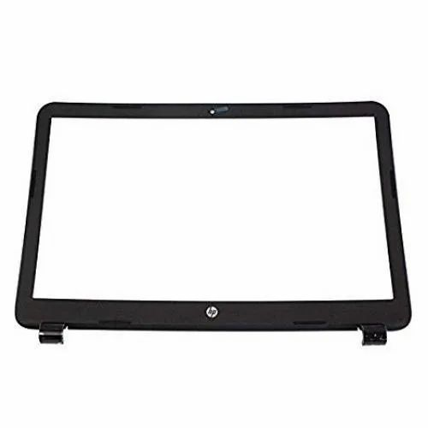
ABS
Noted for engineering properties such as good impact and mechanical strength
Acrylonitrile - heat resistance, weather resistance
Butadiene - toughness
Styrene - rigid, high gloss, low cost.
ABS cost ~60% more than PS, but better performance warrants price.
ABS is opaque and amorphous.
Applications: The major use for ABS is for pipe and fittings, mainly drain waste and vent pipe in building. Other uses are automotive parts, appliance parts such as refrigerator door liners, computer housings and covers.
Laptop panel

Slide 33
PTFE - high temp. thermoplastic
High temperature thermoplastic
Small size of F atom and regularity of atoms in polymer gives a highly dense crystalline material (density range- 2.13 to 2.19 g/cm³)
Crystalline melting point of 327⁰C.
PTFE has excellent resistance to chemicals.
Impact strength is high but tensile strength is low. Fillers can be used to increase the tensile strength.
It is slippery and has a low coefficient of friction
Has useful mechanical properties in the temp. range : -200⁰C to 260⁰C
Disadvantage: Due to high viscosity, it is difficult to process so unconventional processing is done by compressing granules at room temp. at 14 to 69 Mpa and then sintering at 360⁰C to 380⁰C.

Slide 34
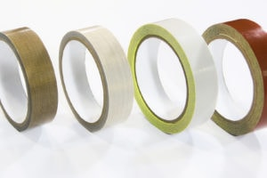
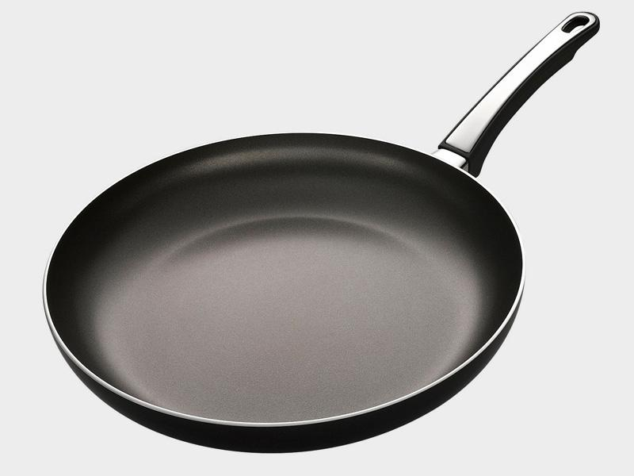
PTFE
Applications:
Non-stick coatings (low coefficient of friction)
Tapes
Chemically resistant pipes and pump parts
Molded electrical components
Low friction bearings
A commercial brand: Teflon

Slide 35
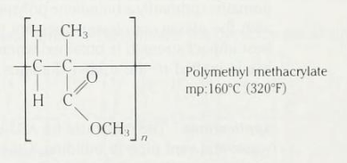
Polymethyl methacrylate
PMMA is the most important material of the group of thermoplastics known as acrylics
It is a hard, rigid transparent thermoplastic which has good outdoor weatherability and is more impact resistant than glass.
Structure and properties :
Methyl and methacrylate groups on every other carbon atom of the main chain provides considerable steric hindrance and thus makes PMMA rigid and relatively strong.
Advantages :
UV resistant
Good impact strength
Crystal clear and has high transparency to visible light
Disadvantages:
Brittle
Poor solvent resistance

Slide 36



Polymethyl methacrylate
Applications: Skylights, windows, windshield
hard contact lenses
Protective goggles
Auto taillight lenses
windshield
skylight

Slide 37
Engineering plastics
Engineering polymers are designed to give improved strength or better performance at elevated temperatures. These materials are produced in relatively small quantities and often are expensive. For most of them the maximum-use temperature is 260⁰C; others—usually in a fiber form—have strengths that are greater than that of steel.
Some general properties are as follows:
High strength to weight ratio
Retains stiffness at high temps
(high heat deflection temperature, HDT)
They have good corrosion resistance to many environments.

Slide 38
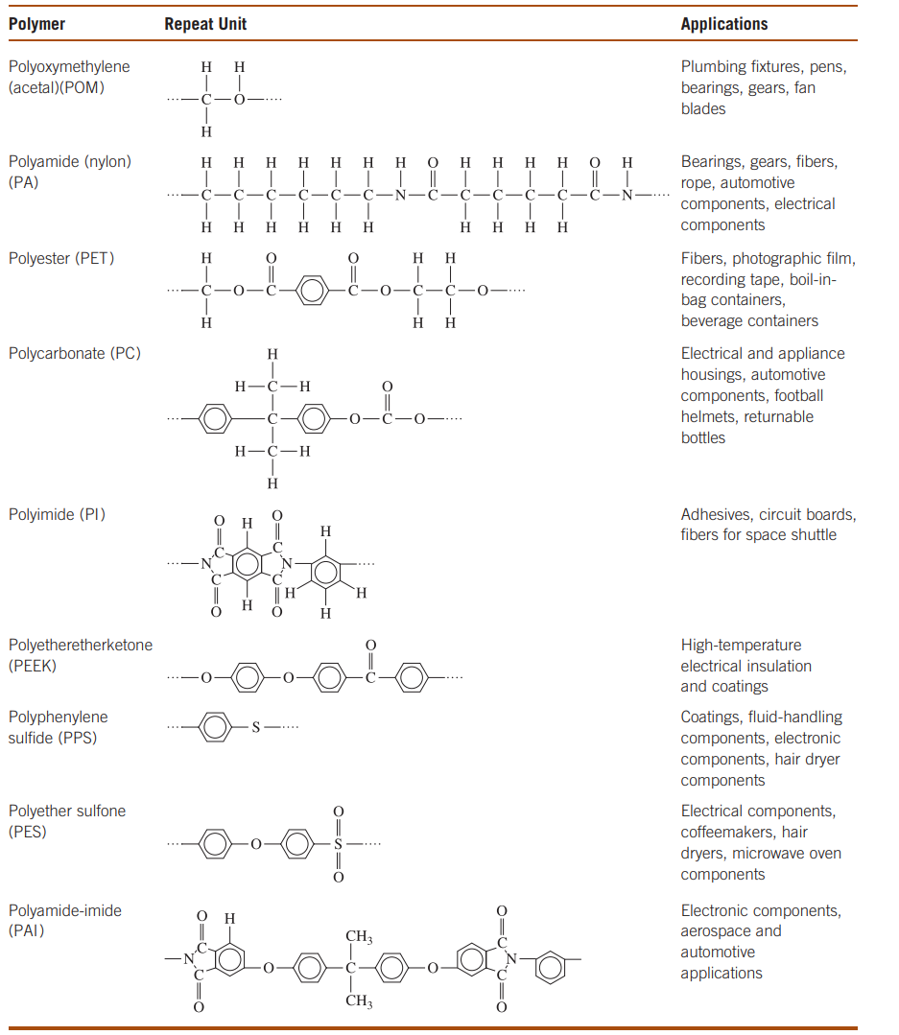
Engineering thermoplastics
College of Engineering Pune (COEP)
Forerunners in Technical Education

Slide 39
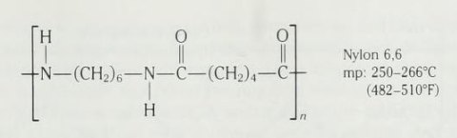
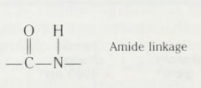
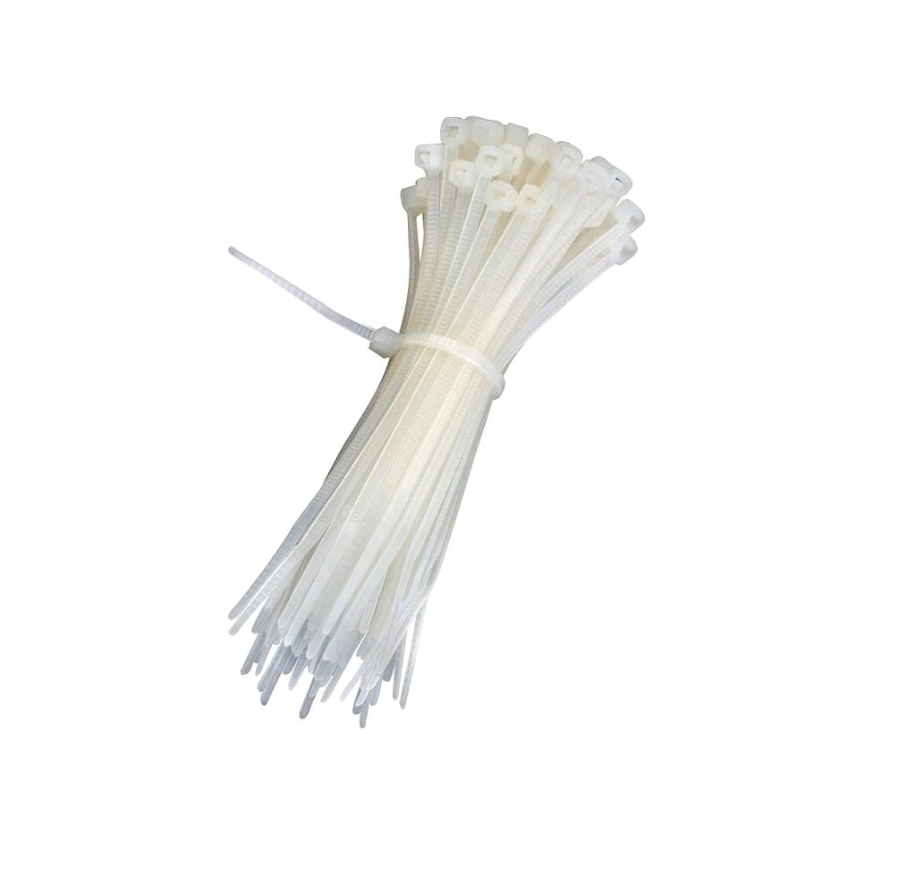
Nylon (Polyamide)
Cable ties

Slide 40

Nylon (Polyamide)
High strength
High heat deflection temperature
Good chemical resistance
High lubricity and low surface friction due to flexibility of carbon chains
Most nylons processed by injection molding and extrusion methods.
Highly crystalline polymeric materials due to symmetry in the main polymer chains. Under controlled solidification conditions spherulites can be produced.
Applications of PA66 : Textiles, bushings, gears, cable ties
Partly due to hydrogen bonding (-NHO type) between the molecular chains.

Slide 41
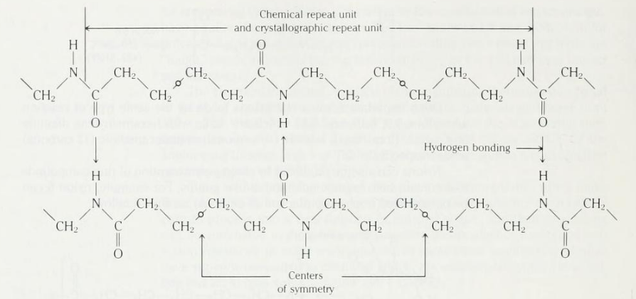
Fig: Hydrogen bonding between two molecular chains
Disadvantage: Polarity and hydrogen bonding of amide groups causes high water absorption which results in dimensional changes with increasing moisture content. Must be dried prior to processing

Slide 42
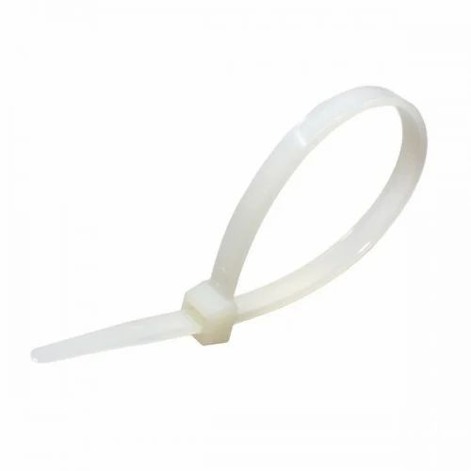
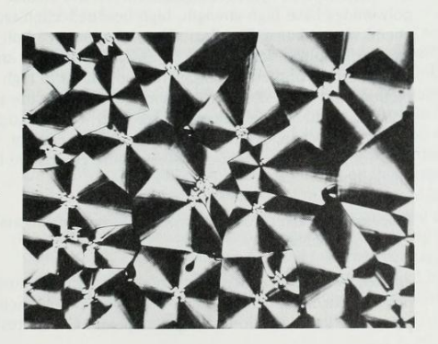
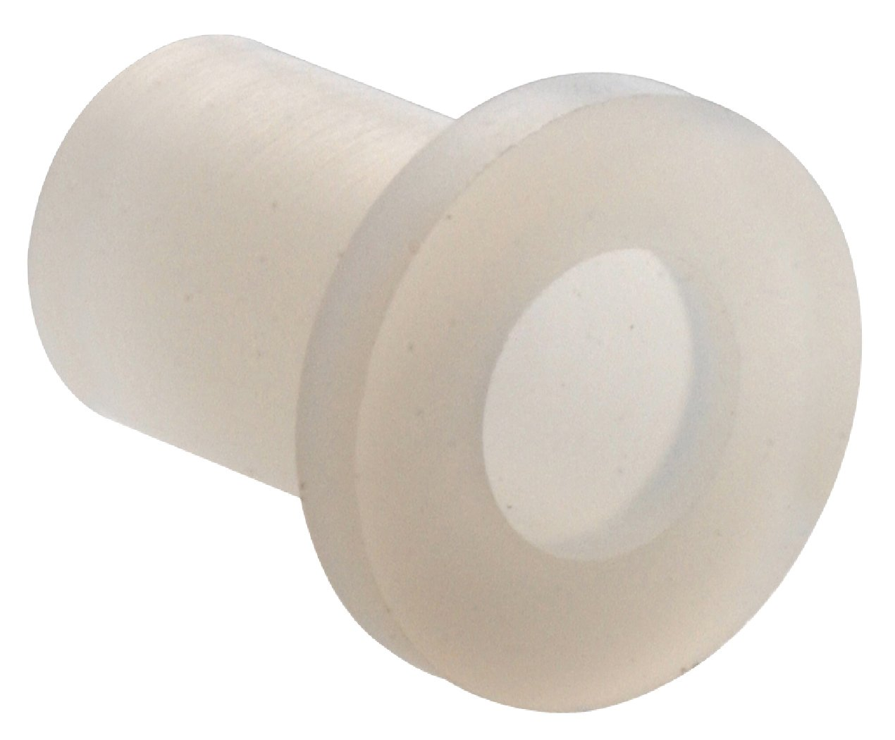
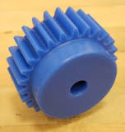
Nylon cable tie
bushing
Spherulitic structure of nylon 9,6 grown at 210⁰C
gear

Slide 43
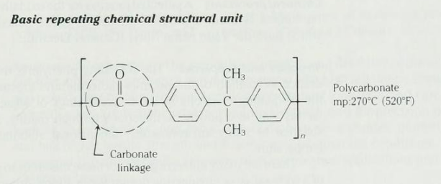
polycarbonate

Slide 44
polycarbonate
Considerable steric hindrance due to 2 phenyl and 2 methyl groups attached to the same carbon atom which makes it stiff
However, C-O single bond in the carbonate linkage gives some flexibility producing high impact energy
High tensile and impact strength
High toughness
Dimensional stability unlike nylon
Good creep resistance
Good electrical insulating properties
Transparent : crystal clear (Amorphous polymer)
Disadvantage: Limited resistance to solvents

Slide 45
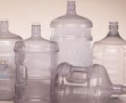
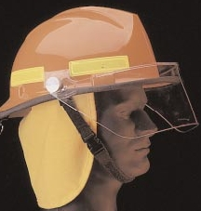
Applications of polycarbonate
CDs and DVDs
large water bottles
Football & safety helmets
headlights

Slide 46
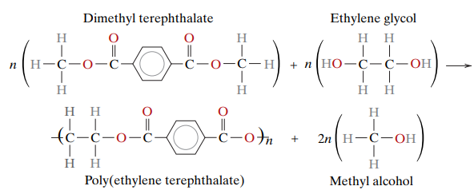
Polyethylene Terephthalate (PETE)

Slide 47
Polyethylene Terephthalate (PETE)
H
H
O
O
~
C
C
O
C
C
O
~
H
H
n

Slide 48
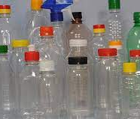
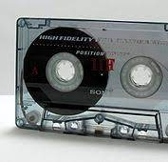
PETE in its stable state, is a semicrystalline resin
Tough and rigid
Clear and colorless
Outstanding chemical resistance
Disadvantage:
Relatively low thermal resistance (soda bottle shrinks when boiling water is poured into it)
Applications:
Bottles, used as a fiber for clothing, food and product packaging, magnetic tape

Slide 49
Thermosets
Thermosetting plastics are highly cross-linked polymers that form a 3D network structure
Good strength, stiffness and hardness
But also, poor ductility, impact properties and high glass temperature
Some thermosets are cross-linked by heat or a combination of heat and pressure. Others may be cross-linked by a chemical reaction that occurs at room temperature
Cross-linking is irreversible so thermosets cannot be reused or recycled
Maximum-use temperature ranges from 77 to 288ºC.
Some advantages of thermosets are:
High thermal and dimensional stability
High rigidity
Light weight
Resistance to creep and deformation under load
High electrical and thermal insulating properties

Slide 50
Thermoplastics vs thermosets
TS are stronger, more heat resistant and more rigid than TP
TS have higher melting point and T_{g} than TP as an increase in cross-linking decreases the mobility of the polymer.
TS can withstand higher temperatures than TP without losing their shape making them more durable in high temperature applications. So TS cannot be reheated and remelted after curing like TP.
Thermoplastics have secondary bonds between molecular chains. Thermosetting plastics have primary bonds between molecular chains and are held together by strong cross-links.
Difference in properties arises because of different molecular structures i.e Thermosets have a network structure and Thermoplastics have a linear structure

Slide 51
Phenol Formaldehyde
Commonly produced by condensation polymerization of phenol and formaldehyde
First major plastic used in industry
High cross linking of aromatic structure produces high hardness, rigidity and strength
low thermal conductivity (pot/pan handles)
high electrical resistance (circuit breakers)
Low cost
Excellent moldability

Slide 52
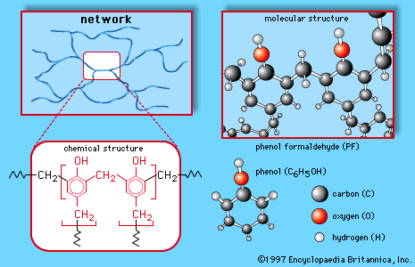

Slide 53
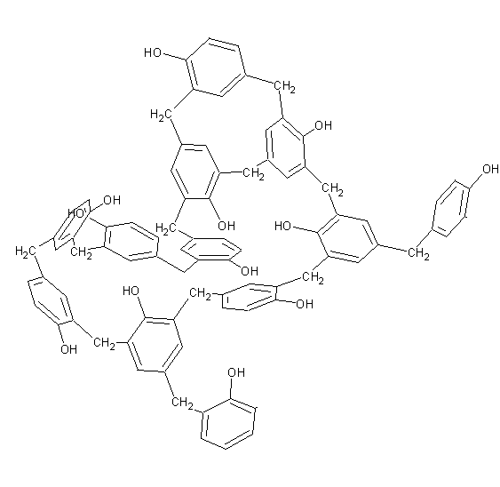
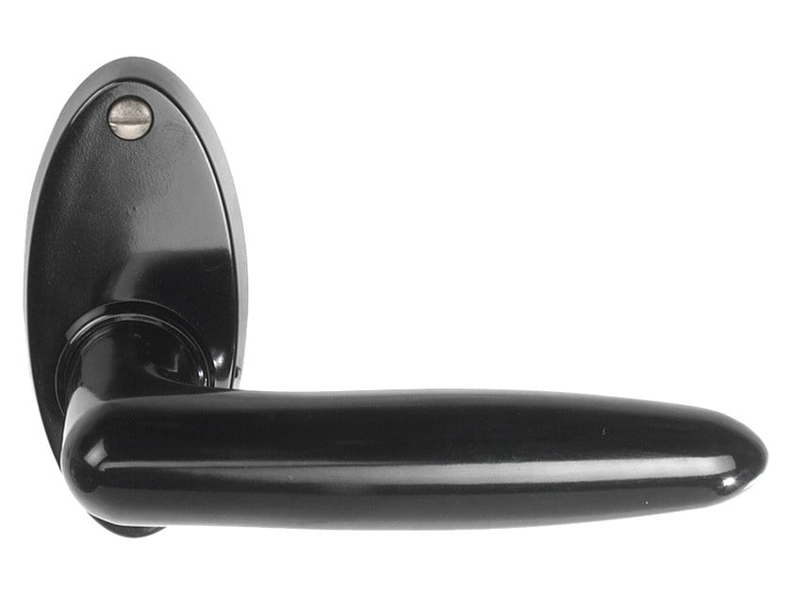


Phenol Formaldehyde
Electrical connectors
Handles, knobs for small appliances
Phenolic resins used in laminating plywood
Door handle
Electrical strip connector

Slide 54

Melamine Formaldehyde
Notable Properties
One of the hardest and stiffest of commercial plastics,
excellent color retention, does not burn
Uses
dishware
laminating resins: Formica (countertops)

Slide 55
Epoxy
Do not give off reaction products when they cure and so low cure shrinkage
Good adhesion to other materials
Good chemical and environmental resistance
Good mechanical and insulating properties
High molecular mobility during processing
Applications:
Adhesives and special paints
Encapsulation of electronic components (Epoxy is a primary resin used in IC’s, transistors etc.)
Epoxy resins used for fiber reinforced matrix materials. Major matrix materials for high performance components

Slide 56

Note that no by-product is given off

Slide 57
Thermoplastic Polyester
H
H
O
O
~
C
C
O
C
C
O
~
H
H
n
Backbone of PET chain has no double bond

Slide 58


Thermoset Polyester
H
H
O
O
~
C
C
O
C
C
C
C
O
~
H
H
H
H
n
Backbone has double bonds (Unsaturated PET)

Slide 59

Peroxide curing agents are used with methyl ethyl ketone (MEK) peroxide used for room temp. curing

Slide 60
Thermoset PET
In combination with glass fibers UP can be cross linked to form high strength reinforced composite materials. Tougher and increased strength with addition of fiber reinforcements
UP resins are low viscosity materials able to be mixed with reinforcements (as high as 80% by weight)
Good chemical resistance
Applications of glass reinforced polyester :
Automobile panels and body parts
Construction industry for building panels and bathroom components
Pipes, tanks and ducts where good corrosion resistance is required

Slide 61

Elastomer
Polymer materials whose dimensions can be greatly changed when stressed and which return to their original dimensions (or almost) when the deforming stress is removed.
Amorphous polymers that don’t crystallize easily during processing
Common uses: Rubber bands, automobile tires, hoses, O-rings, insulation
Common types of elastomeric materials:
Natural rubber (vulcanized)
Polychloroprene
Styrene-butadiene rubber
Nitrile rubber
Silicone
O - rings

Slide 62



Slide 63


Natural rubber
Source of natural rubber is a milky liquid called latex which is a suspension containing small particles of rubber

Slide 64

The cis and trans structures of isoprene. The cis form is useful for producing the isoprene elastomer

Slide 65
Cis and trans isoprene
In trans structure (also called gutta percha), methyl group and hydrogen atom bonded to double bond do not interfere, this arrangement leads to relatively straight chains so trans structure can crystallize into a rigid material.
It is not an elastomer. Used in golf balls and shoe soles
In cis-polyisoprene, the geometry causes the polymer chains to develop a highly coiled structure, preventing close packing and leading to an amorphous, rubbery polymer.
If stress is applied to cis-isoprene, polymer behaves in a viscoelastic manner. Chains uncoil and bonds stretch, producing elastic deformation, but the chains also slide past one another, producing nonrecoverable plastic deformation.

Slide 66
Vulcanization
Chemical process by which polymer molecules are joined together by cross-linking into larger molecules to restrict molecular movement.
In 1839, Charles Goodyear discovered vulcanization process for rubber using Sulfur and lead carbonate as agents
Achieved by a nonreversible chemical reaction, typically carried out at an elevated temperature.
Since cross-linking process is not reversible, the elastomer cannot be recycled easily.
Cross-linking the sulfur atoms gives rigidity to rubber molecules

Slide 67

Cross-linking prevents viscous plastic deformation while retaining large elastic deformation
(b) When cross-linking occurs, the elastomer still may undergo large elastic deformation; however, the elastomer returns to its original shape upon removal of load.
Rubber changes from thermoplastic to elastomer
a) Non-recoverable plastic deformation when the elastomer contains no cross-links.

Slide 68

Vulcanization
a) Cis-polyisoprene chain before sulfur cross-linking
b) Cis-polyisoprene chain after cross-linking with sulfur at the active double bond sites.

Slide 69
Cross linking gives rigidity to rubber molecules.
Also the tensile strength, modulus of elasticity and resistance to degradation by oxidation are enhanced by vulcanization

Slide 70

Vulcanization increases the tensile strength of natural rubber. The magnitude of the modulus of elasticity is directly proportional to the density of the crosslinks.

Slide 71
Density of crosslinks
The number of cross-links determines the elasticity of the rubber or the amount of sulfur added to the material
Typically, 0.5 to 5 wt% sulfur is added to provide cross-linking in elastomers
Low sulfur additions leave the rubber soft and flexible, as in elastic bands or rubber gloves
If sulfur content is increased, cross-linking increases producing less flexible, harder, brittle rubber
A fully rigid structure of hard rubber can be produced with about 45 wt% sulfur

Slide 72

Fillers in rubber
Use of fillers can lower the cost of rubber and also strengthen the materials
Carbon black – commonly used filler for rubber
Finer the particle size of carbon black, greater the tensile strength. Also, increases tear and abrasion resistance

Slide 73

Synthetic rubber - SBR
SBR – Styrene- Butadiene rubber ; most widely used
A butadiene-styrene copolymer
After polymerization, it contains 20-23 % styrene

Slide 74
Synthetic rubber - SBR
Copolymer can be vulcanized with sulfur by cross-linking.
Cis-isomer of butadiene has greater elasticity than natural rubber (methyl group replaced by H in butadiene)
Styrene in copolymer produces stronger and tougher rubber – phenyl side groups along the chain reduce tendency to crystallize under high stresses
Used in many rubber applications because of its lower cost than natural rubber. Ex. Tire threads
Disadvantage: absorbs organic solvent like oil and swells
* Chewing gum contains a base made from styrene butadiene or natural rubber

Slide 75



Synthetic - Nitrile rubber
Copolymers of butadiene and acrylonitrile (55-82 % butadiene and 18-45% acrylonitrile)
But molecular flexibility is lowered due to nitrile group
Costlier than ordinary rubber so limited applications like fuel hoses and gaskets
-Nitrile groups increases hydrogen bonding between adjacent chains leading to higher tensile strength & heat resistance
-They provide good resistance to oils and solvents (ex. Fuel hose)

Slide 76


Silicone rubber
Silicone polymers based on Si and O in the backbone of the chain are called silicones
When X and X’ are replaced by methyl groups (-CH₃) , the polymer is called polydimethyl siloxane (shown in figure below)
Most common silicone elastomer

Slide 77


Silicone rubber
PDMS can be cross-linked with the addition of an initiator at room temperature which reacts two methyl groups together to form Si-CH₂-CH₂-Si bridges. H₂ gets eliminated
Silicone rubbers can be used over wide temperature range (-115 to 315ºC)
Applications for silicone rubber: sealants, gaskets, spark-plug boots, auto ignition cable
Gaskets
Used as sealant

Slide 78

Thermoplastic elastomer
Special group of polymers that do not rely on cross-linking to produce a large amount of elastic deformation. Processing becomes easy
One example is SBS (Styrene-butadiene-styrene) block copolymer.
Crosslinking of butadiene is not required unlike SBR.
Butadiene portions of the polymer have a glass temperature below room temperature and therefore behave in a soft, rubbery manner
The styrene has a high glass temperature; consequently, the domains are strong and rigid and tightly hold the chains together
So elastic deformation is recoverable as sliding of chains is prevented by styrene domains
Applications of SBS: Seatbelt covers, handles (tools, sporting equipment)

Slide 79

Thermoplastic elastomer
When the thermoplastic elastomer is heated, the styrene heats above the glass temperature, the domains are destroyed, and the polymer deforms in a viscous manner—that is, it behaves as any other thermoplastic, making processing very easy
The structure of the styrene-butadiene (SB) copolymer in a thermoplastic elastomer. The glassy nature of the styrene domains provides elastic behavior without crosslinking of the butadiene

Slide 80
Processing methods
Methods used for forming a specific polymer depends on several factors:
whether the material is thermoplastic or thermosetting
If thermoplastic, the temperature at which it softens
Geometry and size of the finished product
Molding is the most common method
several molding techniques used include compression, transfer, blow, injection, and extrusion
For each, a finely pelletized or granulized plastic is forced, at an elevated temperature and by pressure, to flow into, fill, and assume the shape of a mold cavity.

Slide 81
Processing methods
Fewer forming techniques are used for the thermosetting polymers because, once cross-linking has occurred, the thermosetting polymers are no longer capable of being formed.
Fabrication of polymeric materials normally occurs at elevated temperatures and often by the application of pressure.
Thermoplastics are formed above their glass transition temperatures, if amorphous, or above their melting temperatures, if semicrystalline.

Slide 82

Thermoplastic methods (injection molding)

Slide 83

Process overview
Main operations of process:
Plastication (melting of pellets)
Injection
Packing (and holding)
Cooling (starts after gate freezes)
Part Ejection (mold opens/closes)
Injection molded part

Slide 84
Injection molding machine consists of 4 components
Injection Unit – melt pellets, rams viscous melt into mold
Clamp Unit – keeps mold closed during high pressure molding
Mold – defines part shape, cools melt, safe part removal
Controller – injection, clamping, and mold operation

Slide 85
Injection molding
Most important method for forming thermoplastic
Modern injection molding machine utilizes reciprocating screw mechanism for melting the plastic and injecting a more homogeneous melt into a mold
Plastic granules from a hopper are fed through an opening onto surface of a screw drive which carries them towards the mold
Rotation of screw causes granules to melt due to heat of compression, friction and hot walls of cylinder
When sufficient material is melted at mold end of screw, the screw stops and injects a ‘shot’ of melted plastic in a plungerlike motion through a runner – gate system and into the mold cavities.
Screw shaft maintains pressure on the plastic material fed into the mold for a short time till it becomes solid and then is retracted
After the part gets cooled, mold is opened and part is ejected by ejector pins

Slide 86
Injection molding
For thermoplastics, cycle times for this process are short (commonly within the range of 10 to 30 s).
Thermosetting polymers may also be injection molded; curing takes place while the material is under pressure in a heated mold, which results in longer cycle times than for thermoplastics. This process is sometimes termed reaction injection molding (RIM) and is commonly used for materials such as polyurethane

Slide 87

The injection molding process - critical steps
a) Plastic granules are delivered by a revolving screw barrel
b) Plastic granules are melted as they travel along the screw and when sufficient material is melted at the end of screw, the screw stops rotating.
c) Injection of melted plastic through an opening into runner and gate system and then into closed mold cavity
d) Screw barrel is retracted and finished part is ejected

Slide 88
Sequence of critical steps
Clamp closes mold, nozzle forward (close mold)
Screw pushes melt into mold (filling) (injection)
Screw maintains high pressure (packing) (hold)
Pressure is removed after gate freezes,
resin pushed into barrel & melted (plastication)
5. Mold remains closed to cool part (cooling)
6. Mold opens, part removed (ejection)

Slide 89
Advantages and Disadvantages of Injection molding
Advantages:
High quality parts with detailed shapes can be produced at a high production rate
Process can be highly automated and has relatively low labor costs
Good surface finishes can be produced on the molded part
Disadvantages:
Cost of the machine is high so large volume of parts must be made to pay for the machine

Slide 90

Thermoplastic (extrusion)
Extrusion: molten plastic pushed through a die to continuously form a product of uniform cross-section.

Slide 91
Extrusion molding
Widely used technique for processing thermoplastics
Useful in forming certain simple shapes like pipe, rod, sheet, film and other products continuously
Also used for making compounded materials (mixed with additives) for production of raw shapes such as pellets – using twin screw (image on next slide)
In extrusion, the thermoplastic resin is fed into a heated cylinder and a rotating screw (single screw for products) forces the melted plastic through an opening in an accurately machined die to form continuous shapes
Extruded part must be cooled below T_{g} to ensure dimensional stability
Cooling is usually done with an air-blast or water-cooling system
Extrusion also can be used to coat wires and cables with either thermoplastics or elastomers

Slide 92

Fig: Various functional zones of an extruder with their functions:
Feed(compaction), compression(melting), metering (pumping)
Twin screw

Slide 93

Thermoplastic (blow molding)

Slide 94

blow molding
A cylinder or tube of heated plastic called parison is placed between jaws of a mold
The mold is closed to pinch off the ends of the tube
Compressed air is blown in through the mold forcing the plastic against the walls of the mold and it expands to fill the mold. The part is cooled as it is held under air pressure
Uses : This process is used to produce plastic bottles, containers, automotive fuel tanks, and other hollow shapes.

Slide 95


Thermoforming
Thermoplastic polymer sheets heated just above T_{g} can be formed over a die to produce such diverse products as egg cartons and decorative panels. Typical products : large and thin walled
The forming can be done using a vacuum, or air pressure to force the sheet into the contours of a mold.
Vacuum may be used to pull the heated sheet into an open die. Air pressure may also be used to force a heated sheet onto an open die.
Forming temperature : 148.9 ºC
Forming pressure: 14 psi to 100 psi
Vacuum forming

Slide 96

Thermoforming
Thermoforming process

Slide 97

Calendering
In a calendar, molten plastic is poured into a set of rolls with a small opening. The rolls, which may be embossed with a pattern, squeeze out a thin sheet of the polymer—often, polyvinyl chloride. Typical products include vinyl floor tile and shower curtains

Slide 98



Spinning
Filaments, fibers, and yarns may be produced by spinning. The molten thermoplastic polymer is forced through a die containing many tiny holes. The die, called a spinnerette, can rotate and produce a yarn. For some materials, including nylon, the fiber may subsequently be stretched to align the chains parallel to the axis of the fiber; this process increases the strength of the fibers

Slide 99


Melt spinning

Slide 100

Thermosetting (Compression)

Slide 101

Compression molding
Forming pressure – 20.68 MPa
Forming temperature – 165.5 ºC

Slide 102
Compression molding
Commonly used for thermosetting plastics such as bakelite, polyester etc.
Thermoset materials (paste or granules) soften when exposed to heat and pressure. The softer resin flows but then cures into hard thermoset.
appropriate amounts of thoroughly mixed polymer and necessary additives are placed between male and female mold members
Both mold pieces are heated; however, only one is movable.
The mold is closed, and heat and pressure are applied, causing the plastic to become viscous and flow to conform to the mold shape
Preheating of the preform reduces molding time and pressure, extends die lifetime, and produces a more uniform finished piece
Continued heating is required to complete cross-linking of the resin and the part is ejected out of the mold
Excess flash is trimmed later from the part.

Slide 103


Compression molding
Part flash

Slide 104


Compression molding
A panel formed by compression molding

Slide 105
Advantages and disadvantages of compression molding
Advantages of compression molding
Initial mold costs are low because of simplicity of molds
Production of large parts is more feasible
Disadvantages:
Complicated parts are difficult to make with this process
Flash must be trimmed from molded parts

Slide 106


Slide 107

Thermosetting (transfer)
Forming pressure – 20.68 MPa
Forming temperature – 148.9 ºC

Slide 108
Transfer molding
Stock material – Bulk molding compound (BMC) – thermoset which is highly fiber filled
A closed mold method used for molding thermosetting plastics such as phenolics.
Differs from compression molding in how the material is introduced in the mold cavities
The polymer is heated under pressure in one chamber. After melting, the polymer is injected into the adjoining die cavity.
When the mold is closed, a plunger forces the plastic resin from the outside chamber through a system of runners and gates into the mold cavities
After the material has cured, the molded part is ejected from the mold.

Slide 109

Transfer molding
Advantages :
No flash is formed during molding unlike compression molding so less finishing is required for the molded part
Useful for making small detailed parts that would be difficult to make by compression molding
Many parts can be made at the same time using a runner system shown in figure.

